Slide 1
Stuff you should know about CS144
Keith Winstein
Nick McKeown

Slide 2
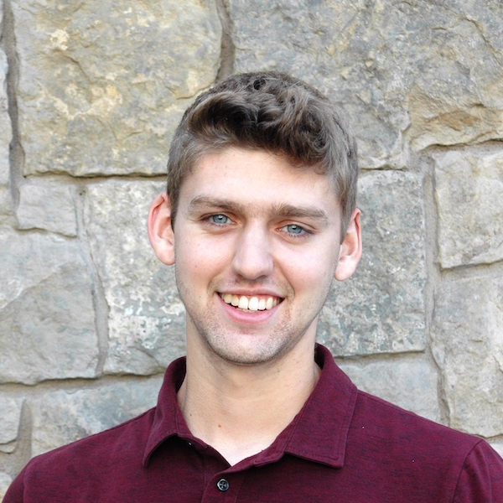
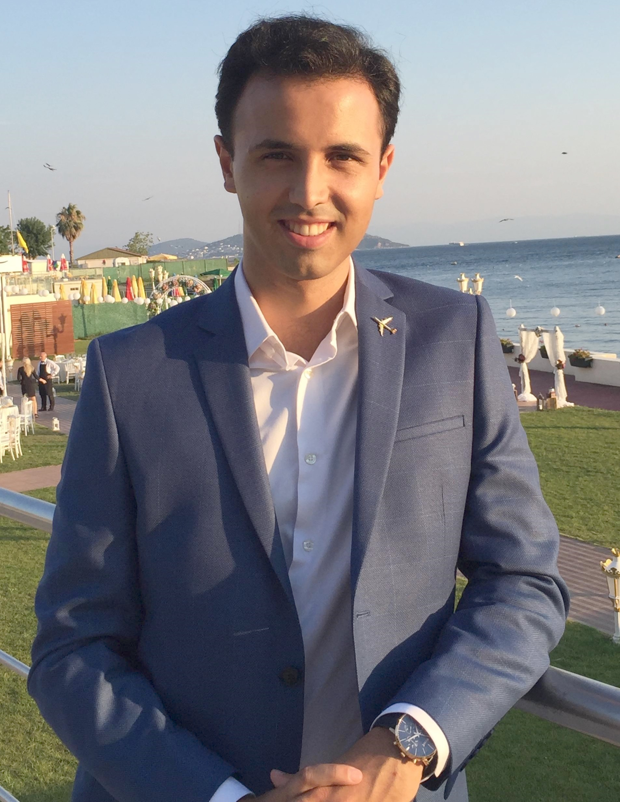
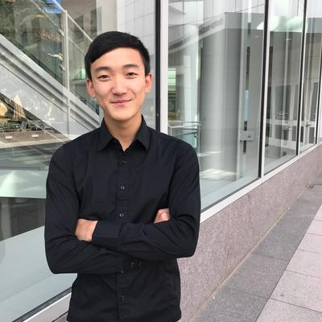
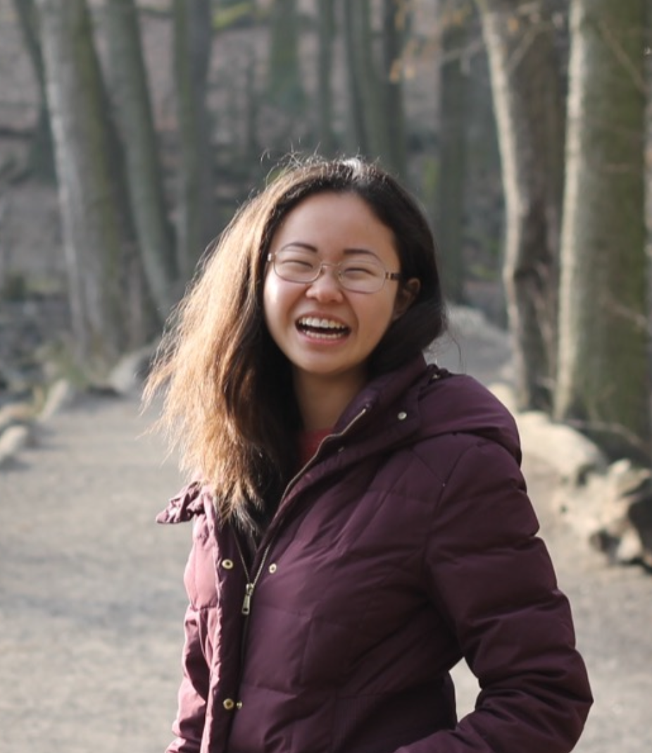
Head TA
Teaching Assistants
Nick Hirning
Serhat Arslan
Toby Bell
Richard Lin
Anna Zeng

Slide 3
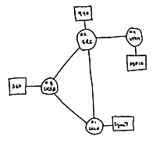
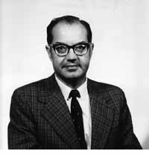
Four nodes connected (UCLA, SRI, UCSB, Utah)
Wireless Communications: 1964
“A network to survive nuclear attack.”
US Government starts “ARPANET” project
1st network connects two computers
Paul Baran
1964
1965
1966
1968
1969

Slide 4
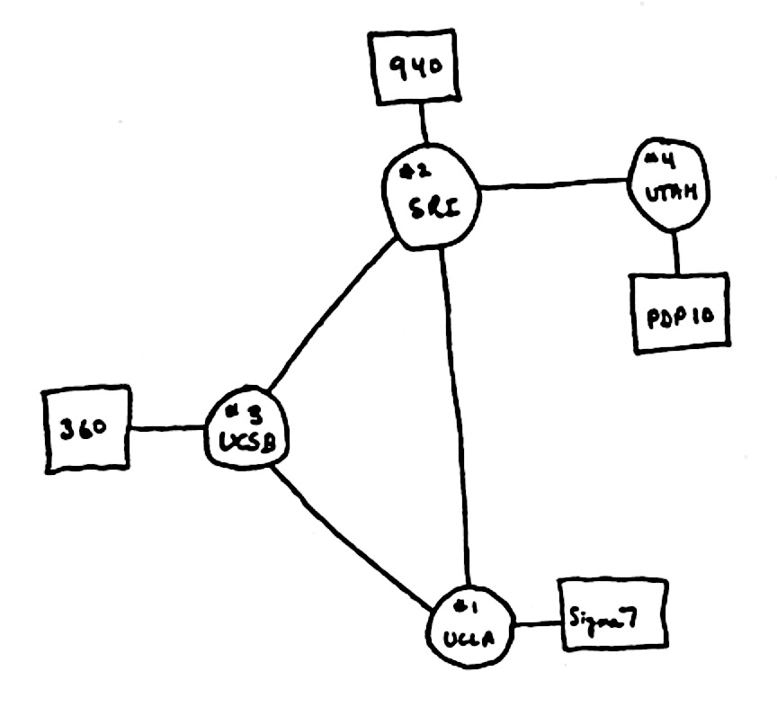
The Internet in 1969
“router”
“end host”
Also in 1969
“link”

Slide 5
What did they use it for?
“router”
“end host”
“link”
Sending files between scientists: “Here is a big file of astronomy data!”
Email: “Where shall we have lunch today?”
Remote login to another computer.

Slide 6
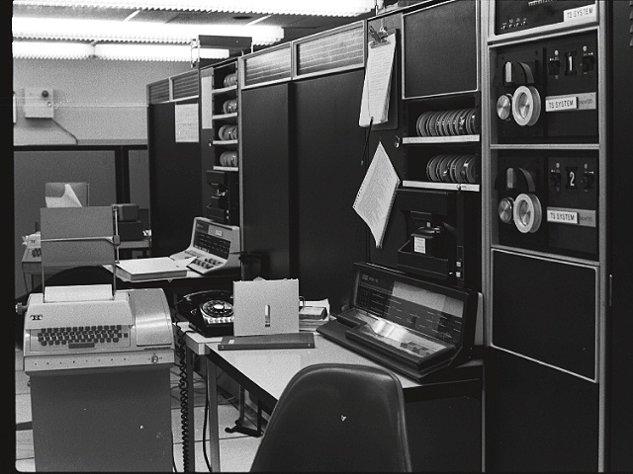
1971
First email typed here
“QWERTYUIOP”
…and printed here

Slide 7
“router”
1993
1,000,000 “end hosts”
“end host”
“link”
1988
10,000 “end hosts”
1969
4 “end hosts”
Network Systems: 1984

Slide 8
Then in 1993 something even BIGGER happened!!!

Slide 9
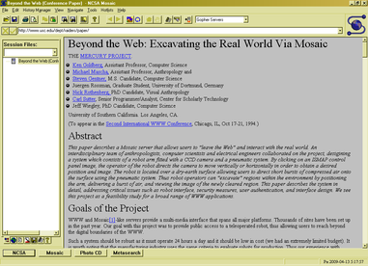
1993: The first web browser (Mosaic)
Marc Andreessen

Slide 10
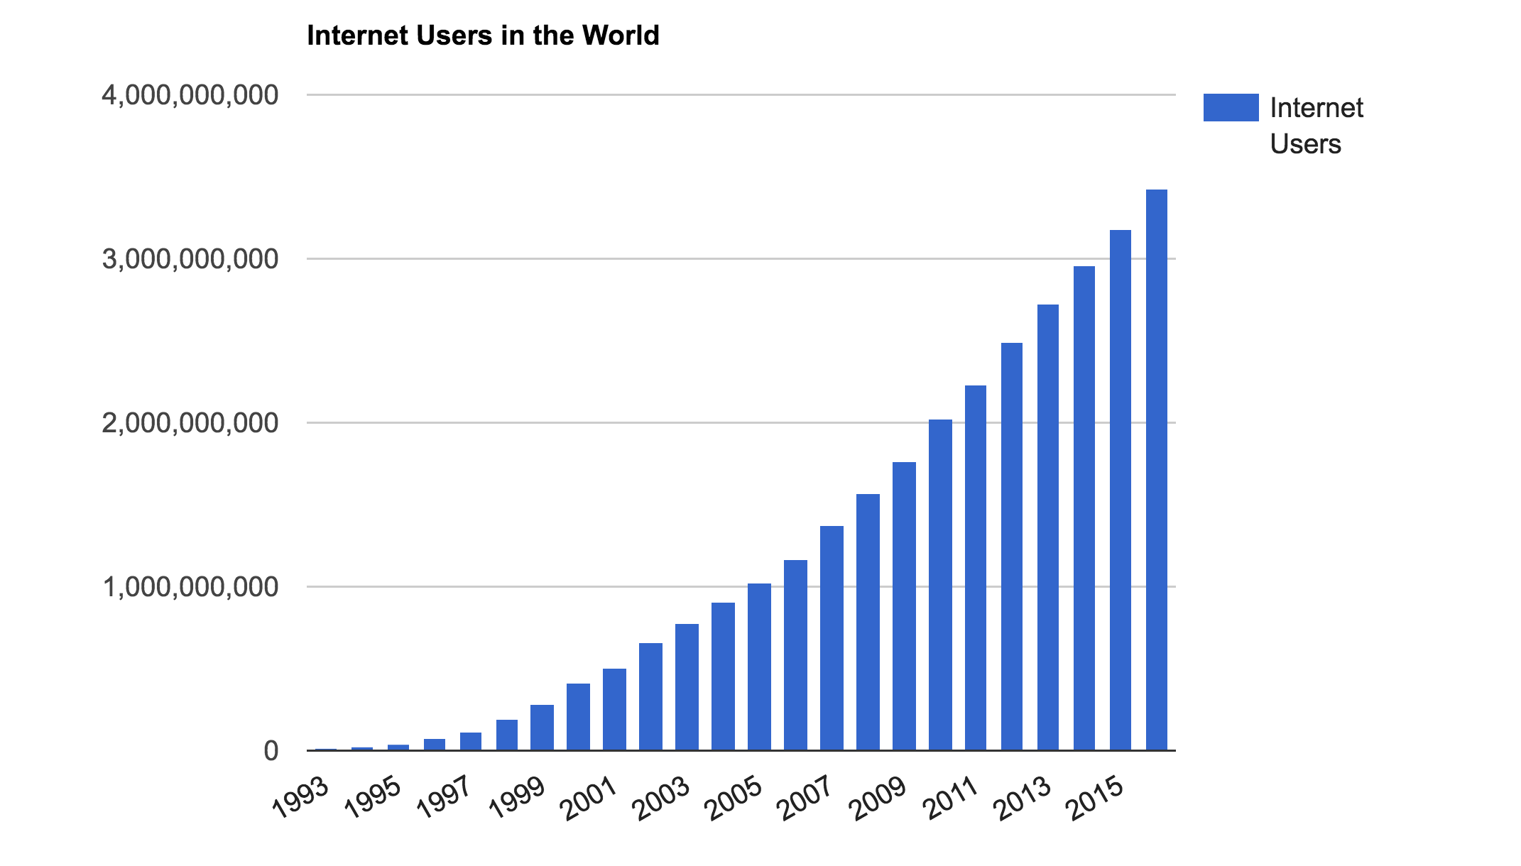
The number of Internet users in the world
3.6B people
~ 40% of world
Source: http://www.internetlivestats.com/
Notes:
Internet user = someone who has access to the Internet from home (by any device)
7.4B in the world, so still less than 50% of people.

Slide 12
How does it all work?
Why was it designed this way?

Slide 13
CS144
Isn’t it really difficult….?

Slide 14
Goals
To learn how the Internet works.
To learn why the Internet was designed this way.
To learn how to use the Internet.
To build some significant pieces of the Internet.
To learn the underlying principles and technologies of networking.
CS144 students are….
ne

Slide 15
How each week goes
CS144 is divided into week-long units, devoted to a particular topic. e.g. the 1st week is about Basic Principles, the 2nd week is about Transport.
There are two types of week:
“Video Weeks”
Three lectures (MWF). Mandatory attendance.
Occasional in-class exercises and guest speakers.
A short pop quiz on Friday in-class.
Videos to watch in your own time.
Short graded online quiz at the end of the unit due Monday 12pm PT.
“Lecture-only Weeks”
Same as above, but no videos to watch and no online quiz.
For example: In week 1 you watch videos about Basic Principles and take the online test before Monday Sept 21st at 12pm. You will have a pop quiz on Friday.

Slide 16
Laptops
We do not allow laptops to be used in class.
Except for specific in-class exercises (we will ask you to bring your laptop) and by the teaching staff.
You should bring a laptop every Friday, for the pop quiz.

Slide 17
How we calculate your grade
Class Attendance 10%
Programming assignments 45%
Lab 0-8: 5% each.
Get started!!!
Quizzes & Exams 45%
End-of-unit quizzes 10% (pop quiz every week; plus online quiz in video weeks)
Midterm: 15% (50mins, in-class)
Final: 20% (120mins, in scheduled slot)

Slide 18
How we calculate your grade
Programming assignments 50%
8 Labs (5% or 10% each)
Get started!!!
Quizzes & Exams 50%
End-of-unit quizzes 10% (online quiz in video weeks)
Midterm: 20% (50mins)
Final: 20% (50mins)

Slide 19
Exam Policy
Exams are closed-book, closed-note, closed-laptop etc.
But you may bring 2 double-sided sheets of 8.5” x 11” paper of your own design to the Midterm and Final.

Slide 20
Exam Policy in the time of COVID
We are working on exam details and will let you know…

Slide 21
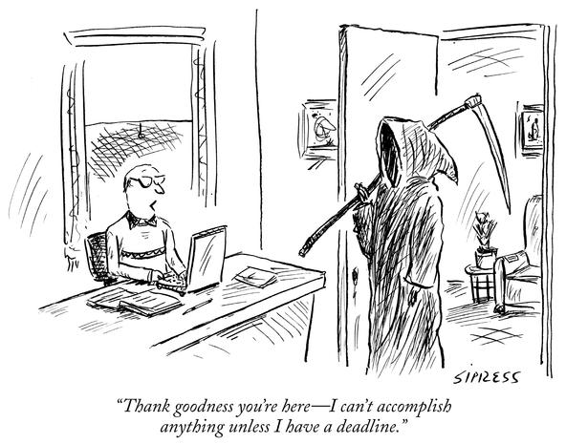
Labs
Programming is in C++
CS110 is a prerequisite.
Late policy:
3 late days (24 hours) of your choosing.
At most 2 late days for one lab.
After you use up your late days, late labs are not graded.

Slide 22
Win Certificates!!!
Your name here
For each Lab:
Certificate for BEST submission,
Certificate for FIRST CORRECT submission.

Slide 23
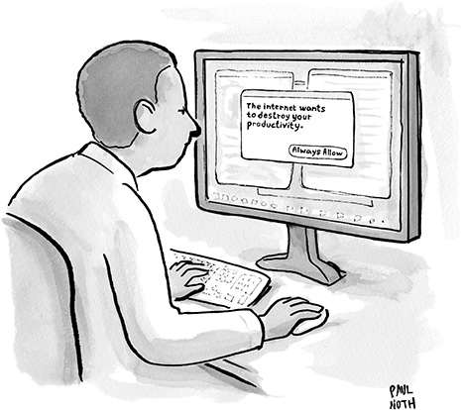
Workload
This is a 4-unit workload, which means a workload of about 12hrs/week
Our estimate based on previous years
Videos and quizzes: 0-3hrs/week
Class time: 3hrs/week
Labs and preparing for exams: Avg 6hrs/week
Average overall 9-12hrs/week

Slide 24
Contact
For anything non-private: Piazza
If private: Private Piazza posting, or email cs144-aut2021-staff@mailman.stanford.edu
If it’s personal (e.g. a medical emergency):
email Nick or Keith nickm@stanford.edu and keithw@cs.stanford.edu

Slide 25
The Honor Code
We take it seriously and we expect you to take it seriously too.
Last year was a bad year with several CS144 students getting into a lot of trouble ☹
None of them had set out to cheat: At the last minute, they copied an assignment off the web, then tried to modify it. It doesn’t work!
We use special tools to compare solutions against current and previous years and solutions we find on the web.
Please, let’s have a zero-violation year.

Slide 26
The Honor Code
Permitted Collaboration: The following items are encouraged and allowed at all times for all students in this class:
Discussion of material covered during lecture, problem sessions, or in handouts
Discussion of the requirements of an assignment
Discussion of the use of tools or development environments
Discussion of general approaches to solving problems
Discussion of general techniques of coding or debugging

Slide 27
The Honor Code
Unpermitted Collaboration: All submissions must represent original, independent work. Some examples of activities that do not represent original work include:
Copying solutions from others or knowingly allowing others to copy your solution.
Use of solutions posted to websites is prohibited.
Placing your source code in a public repository where others can copy it is unpermitted collaboration.
Debugging code for someone else.
Collaborating on or discussing the online graded quizzes before you have completed them.

Slide 28
What to do next
Look around and get familiar with https://cs144.stanford.edu
Watch half the Unit 1 videos before Wednesday’s class. These videos are quite simple and descriptive and should be a quick watch; 1.5x speed-up should work well.
Start working on Lab 0! It is due next Monday.

Slide 29
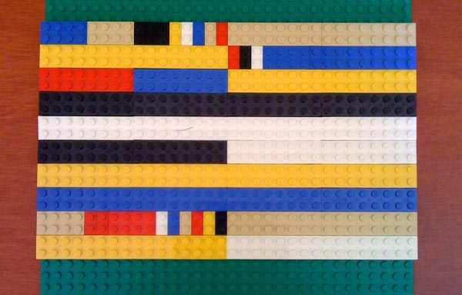
TCP/IP Header Formats in Lego

